Slide 1
On- Demand MBS Data Analytics
An Interactive and Comprehensive Data Analytics Service on U.S. MBS Collaterals and Securities Provided at www.cprcdr.com

Slide 2
About CPR & CDR
Established in year 2000 in San Jose, California.
We are a TechFin company specializing in the big Artificial Intelligence data engine driven prepayment analytics.
Designed and implemented UBX System, a massively parallel and distributed data analytical system, using our patented sorter.
Our data center has over 500 Intel Xeon CPU based computers
Over 1 PB data storage capacity
Hosting the whole U.S. MBS pool and loan level dataset
Our customers can use our web interface to slice-n-dice the massive amount of MBS data, perform ad-hoc queries in real time

Slide 3
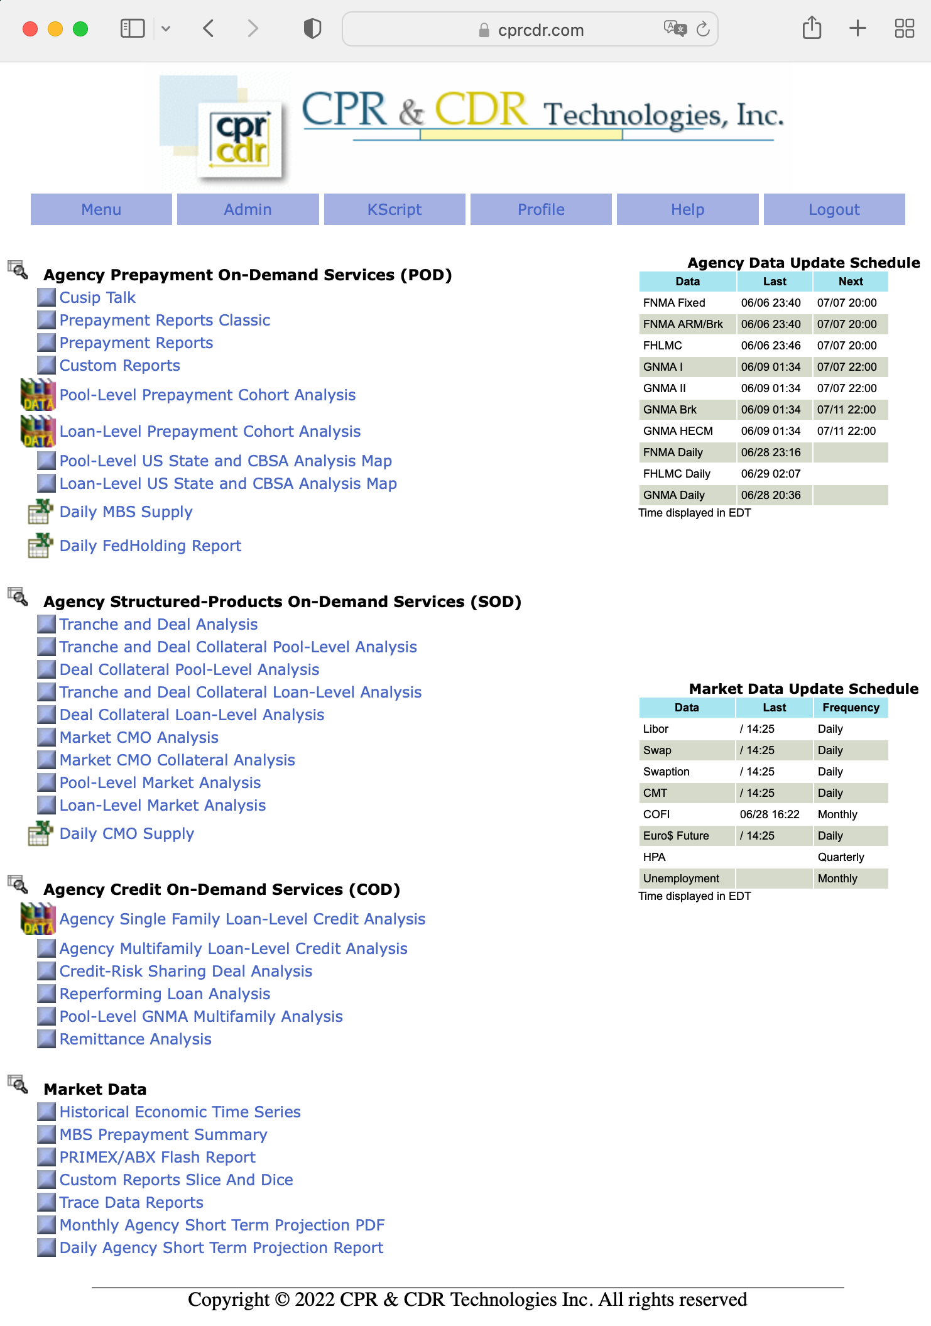
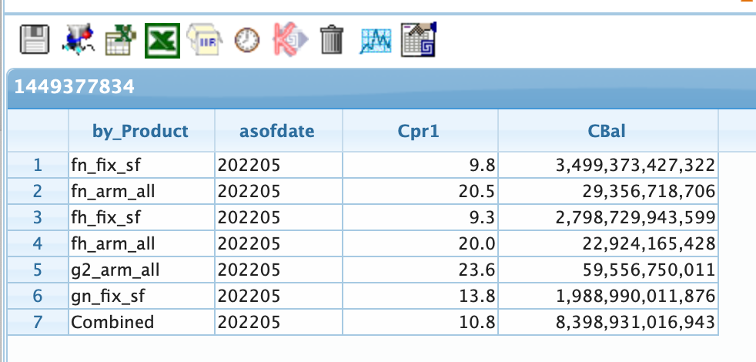
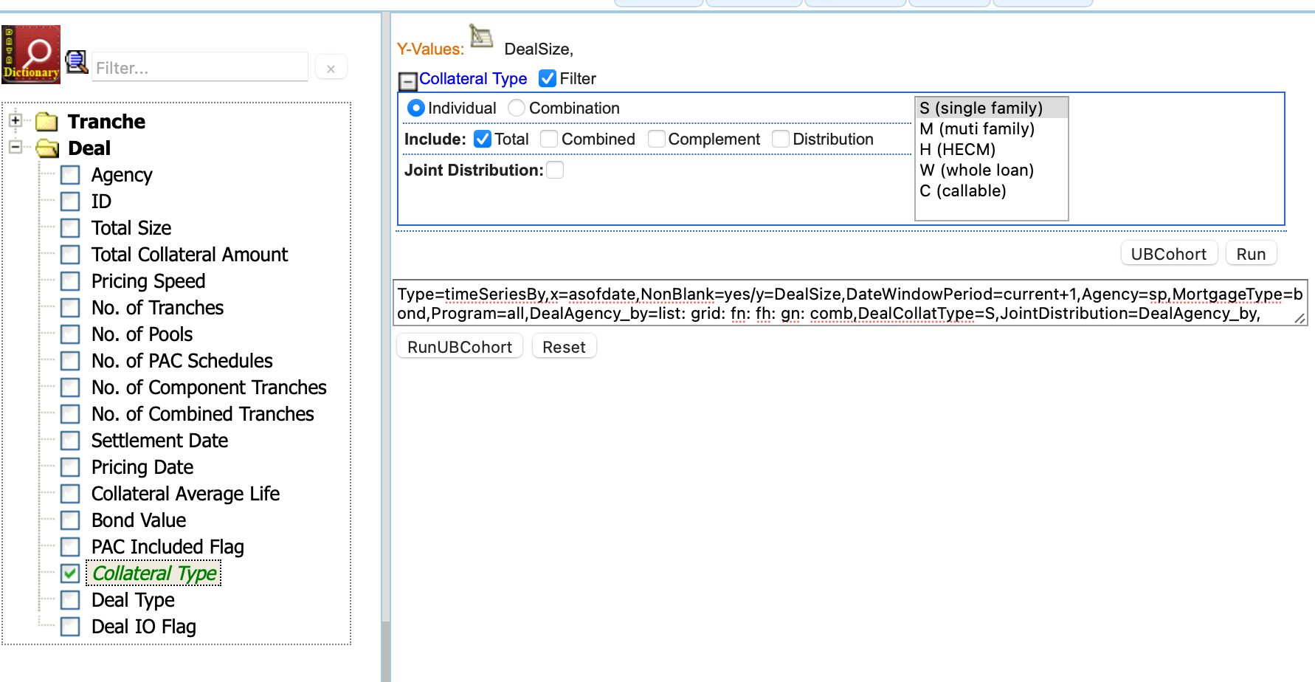
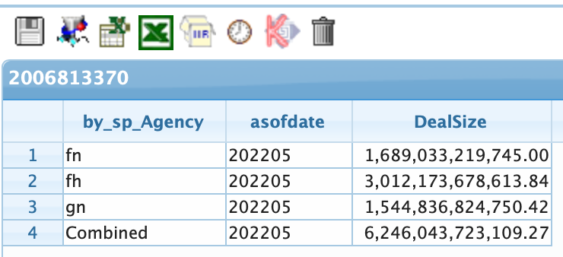
Comprehensive MBS Data Coverage
POD: agency MBS dataset
Pool-level dataset:
2,672,822 pass-through MBS pools from Fannie Mae, Freddie Mac and Ginnie Mae
Total active balance: $8.4T
Data history goes back to 1981.
Loan-level dataset
Data history goes back to 2006
Total loan count: 146,033,306
SOD: agency CMO and STRIPs
CMO/STRIP bond-level queries
Covers 506,968 CMO bonds
CMO deal-level queries
Covers 65,042 CMO collateral groups
Total deal count: 13,352, total deal size: $6.2T
CMO/STRIP collateral analytics
Linked CMO securities to the backing MBS collaterals

Slide 4
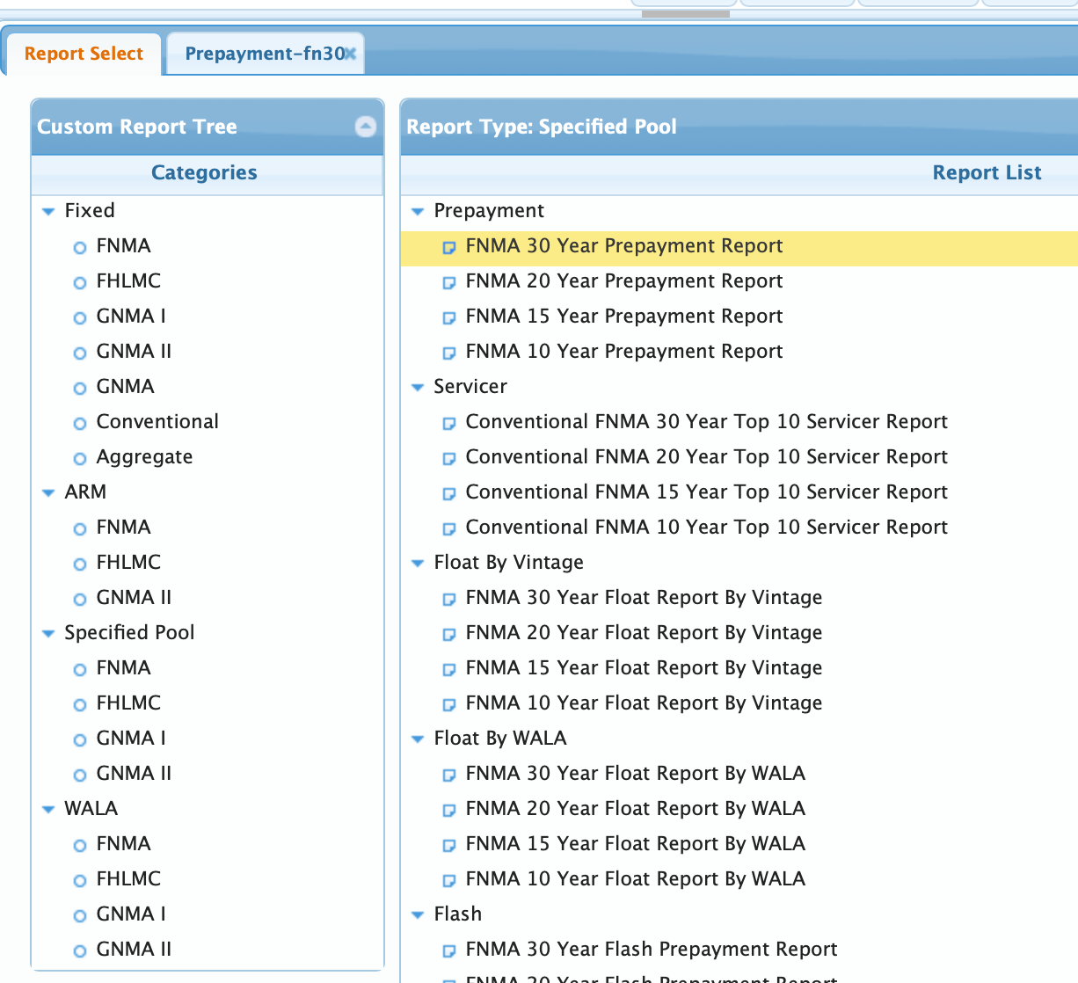
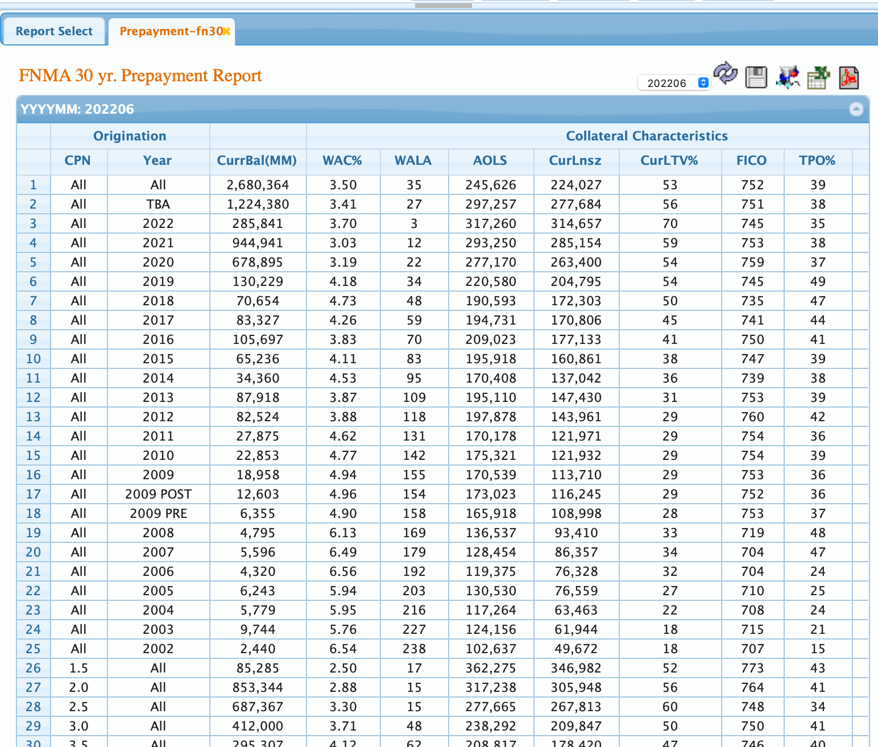
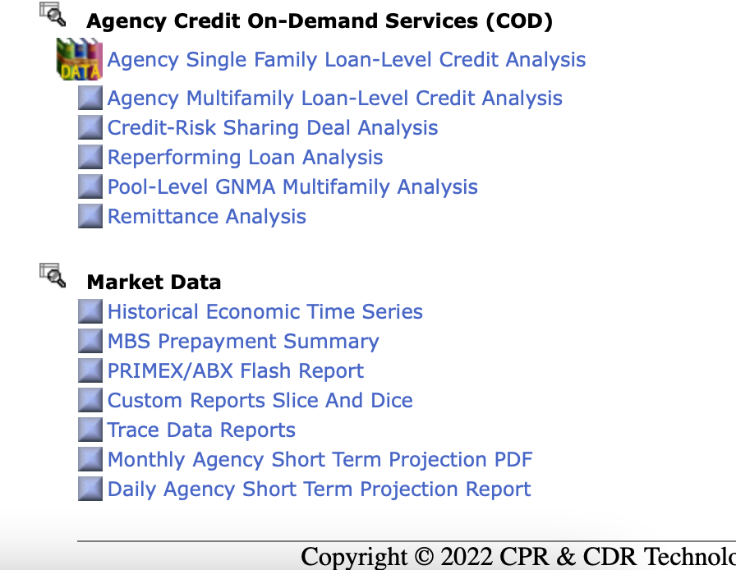
Comprehensive MBS Data Coverage (continued)
COD: credit analysis data on agency and non-agency
CRT deals loan-level dataset
Complete history of CAS, STACR, CIRT, ACIS deals
Total 31,758,718 loans, current active balance $3,450,654,956,523
Remittance Analysis dataset covering non-agency loan-level data
sourced from various trustee websites
Total 22,508,512 loans, current active balance: $298,465,763,849
Market Data
Various mortgage rates
CMT, LIBOR rates
Home Price Index (HPI)
Unemployment rates
Prepayment reports

Slide 5
Credit Risk Transfer Products
Programs are designed to distribute a portion of Freddie Mac’s and Fannie Mae’s mortgage credit risk to third-party participants.
GSEs take first loss position, then investors take a middle tranche, then GSEs take catastrophic risk above that.
See greater details at the following links:
https://crt.freddiemac.com/_assets/pdfs/single-family-crt-handbook.pdf
https://capitalmarkets.fanniemae.com/media/6531/display
Securities are aimed at buyers of Mezzanine down to B credit bonds.
STACR and CAS bonds are floating rate over SOFR.
Yields range from about 3.5% to 15%.

Slide 6
Two Levels of Credit Risk Transfer Products
Structured Agency Credit Risk (STACR®)
Connecticut Avenue Securities® (CAS):
These two programs respectively transfer risk to the private capital markets through the issuance of unsecured and non-guaranteed notes. The bankruptcy remote trusts make periodic payments of P&I on the notes to investors.
Credit Insurance Risk Transfer (CIRT™):
These transactions entail the purchase of collateralized credit insurance on pools of mortgage loans. The collateralized nature helps to mitigate counterparty exposure for Fannie Mae, supplementing the upfront financial review and/or investment grade rating required of each insurer.
Fannie Mae may leverage an entity to facilitate the pass through of credit risk and insurance premiums to reinsurers and subsequent loss recoveries from the reinsurers back to Fannie Mae or transfer risk to an insurance company that holds the risk and provides insurance coverage directly to Fannie .
Agency Credit Insurance Structure (ACIS®):
Insurance policies issued by or ceded to global (re)insurance companies to cover a portfolio of credit risk on the STACR or standalone reference pools. Freddie Mac pays monthly premiums to (re)insurers, based on their tranche participation, in exchange for claim coverage on their portion of the reference pool.

Slide 7
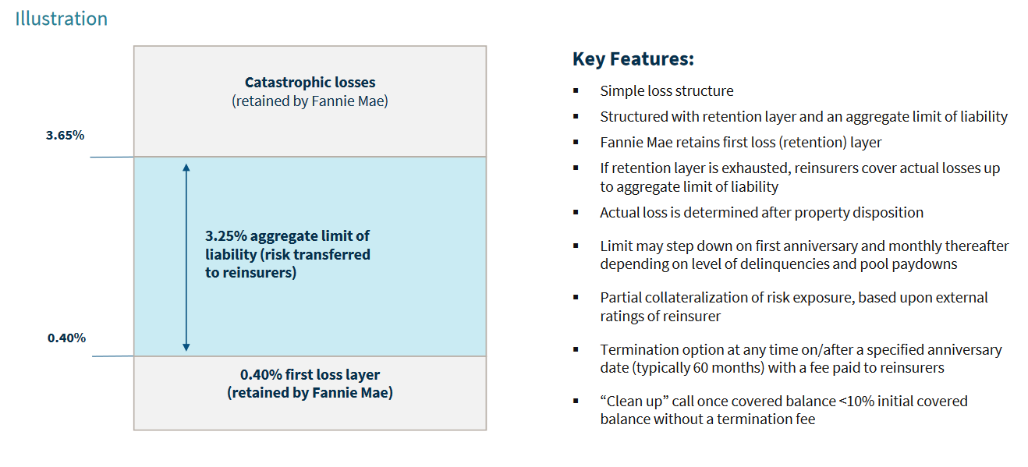
CIRT Insurance Policy Structural Overview

Slide 8
Transaction Volume
Freddie Mac:
Years since first transaction 8
Transactions issued across single-family CRT offerings 163
Unique investors in single-family CRT offering 305+
Risk transferred to private capital on single family mortgages: $86 Billion
Single-family mortgages with credit risk protection $2.7 Trillion
Fannie Mae:
Years since first transaction 8
Transactions issued across single-family CRT offerings 113
Unique investors in single-family CRT offering 251
Risk transferred to private capital on single family mortgages: $72 Billion
Single-family mortgages with credit risk protection $2.4 Trillion

Slide 9
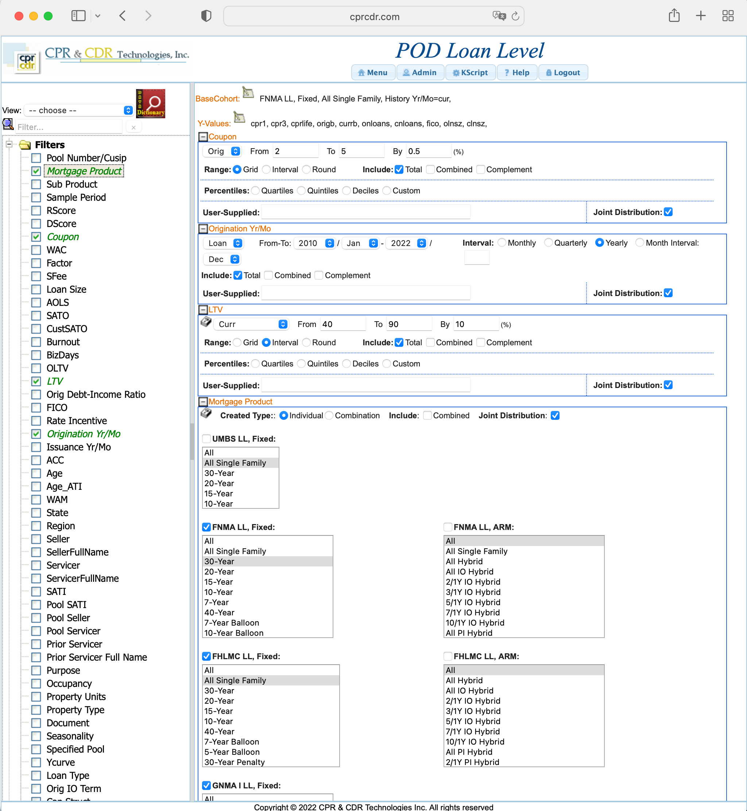
Interactive Interface for Ad-hoc Queries
Computed y-values
Coupon buckets 2 to 5 by 0.5
Massively parallel distributed analytical platform
108 compute nodes, fully redundant system
API access from Python programs or Excel add-ins
Thousands of computed fields available for user’s query
UBCohort: a flexible, almost limitless, ways to construct queries, e.g., for the query shown on the left:
Type=timeSeriesBy,x=asofdate, NonBlank=yes, KeepByVarOrder=1/y=cpr1:cpr3:cprlife:origb:currb:onloans:cnloans:fico:olnsz:clnsz, DateWindowPeriod=current, OrigCoupon_by=cont:grid:2:5:0.5:all, OriginationLoan_by=cont:range:201001:202212:12m:all, CurrLtv_by=cont:range:40:90:10:all, Product_by=list:grid:fnll_fix_30:fhll_fix_sf:g1ll_fix_30, JointDistribution=OrigCoupon_by: OriginationLoan_by: CurrLtv_by: Product_by,
Annual vintage buckets 2010 to 2022
Curr LTV buckets 40 to 80 by 10
Mortgage product buckets

Slide 10
Agency MBS Monthly Updates and Reporting
MBS monthly updates are repleased by the agencies on the 4th and 6th business day.
Flash reports generated within 35 seconds of the data release:
3.1M precomputed pool-level data records involved for preparation
0.51M pool factor updates are downloaded and processed simultaneously
Monthly reports are produced for the factor data release on the 4th and 6th business day

Slide 11
Agency MBS Monthly Updates and Reporting (continued)
On the 4th Business Day, the following reports are produced:
FN & FH SpecPool Report
FN & FH Servicer SpecPool Report
FN & FH Prepayment Pool-by-Pool Conventional Report
FN, FH & Conventional New Issuance Report
GN SpecPool Report
GN Servicer SpecPool Report
Conventional & GN Multi-Pool Fixed Servicer Report
Conventional & GN ARM Servicer Report
Conventional & GN Float Vintage Report
Conventional & GN Float WALA Report
Conventional & GN Servicer WALA Report
Conventional & GN fixed Prepayment Report
Conventional & GN ARM Prepayment Report
Conventional & GN Prepayment GEO Report
G2 30-Multi & 30-Jumbo Pool by Pool
G2 30-Multi & 30-Jumbo Loan level Pool by Pool
Conventional & GN New Issuance Report
On the 6th business day, the following reports are produced:
GN SpecPool Report
GN Servicer SpecPool Report
G2 Multi-Pool Fixed Servicer Report
G2 Arm Servicer Report
GNMA Float Vintage Report
GNMA Float Wala Report
GNMA New Issuance Report
GNMA Servicer WALA Report
GNMA fixed Prepayment Report
GNMA Arm Prepayment Report
G2 30-Multi & 30-Jumbo Pool by Pool
G2 30-Multi & 30-Jumbo Loan Level Pool-by-Pool
GN Prepayment GEO Report

Slide 12
Risk Valuation with Our Scores
In 2015, we released our Scores to evaluate the risks related to MBS bond pricings.
P-Score: Prepayment Score, predicts the probability of voluntary prepayment over the next 12 months.
D-Score: Default Score, predicts the probability of involuntary prepayment over the next 12 months.
Q-Score: Delinquent Score, predicts the probability of 60+ days delinquent over the next 12 months.
B-Score: Buyout Score, predicts the probability of buyout in over the next 12 months.
The higher the score, the lower the corresponding risk.
The scoring model uses a host of the associated loan-level or pool-level characteristics as well as the macro economics including interest rate, home price index, etc.
Scores are available for all CPR & CDR on-demand MBS data analytics.

Slide 13
Variables for Score Models
The variables for MBS risk score models are listed as below:
Variable | Description | Variable | Description
Agency | Agency (GSE/GNMA/FHMA/FHLMC/Non-Agency) | Document | Document Type
OrigMo | Origination Date | PropType | Property Type
PerfMo | Performance Date | UnitNo | Number of Units
Time | Normalized Age; Time = Age/Term | Occupancy | Occupancy
Rate | Current Interest Rate | LoanType | Loan Type
FICO | FICO Score | State | Sate
Term | Loan Term | Season | Season
SATO | current SATO | AppValue | Appraisal Value
Loan | Original Loan Amount | SalePrice | Sale Price
SchPmt | Scheduled Monthly Payment | Servicer | Servicer
LTV | Loan-to-Value Ratio | Seller | Seller
DTI | Debt-to-Income Ratio | NBorrower | Number of Borrowers
DiffRate | Rate Difference; DiffRate = Current - Original Int Rate | 1stBuyer | 1st Time Buyer
ProdType | Product Type | MInsPct | Mortgage Insurance Percentage
Purpose | Purpose | CLTV | Current Loan-to-Value Ratio
Channel | Channel | CCombLTV | Current Combined LTV
CombLTV | Original Combined LTV | EIT | Economic Incentive at Time T, in bps

Slide 14
Score Trend
Below is a POD pool level sample UBCohort to query the 4 scores:
Type=timeSeriesBy,x=asofdate, NonBlank=yes, KeepByVarOrder=1/y=currb:origb:RScore:Dscore:Bscore:QScore, DateWindowPeriod=current-35:current, Product_by=list:grid:fn_fix_all:fh_fix_all:gn_fix_all, JointDistribution=Product_by,
Taking PScore and DScore as an example, the historical trend of FNMA, FHLMC and GNMA in the past 3 years is shown in the chart below. We can see that the PScore shows an upward trend since late 2021, indicating that the probability of prepayment in the next 12 months will decrease. The DScore is increasing steadily, indicating that the probability of default in the next 12 months will also decrease. Both trends are consistent with the Fed’s raising benchmark interest rates behavior. With both the prepayment and the default risk reduced, there is a high probability that the price of MBS bonds is going to rise, so now is a good time to buy MBS bonds.
PScore
DScore

Slide 15
MScore And The Applications
We also developed a bond pricing tool - MScore. MScore is based on the five risk scores as well as some bond characteristics, with a range from 100 to 999. The higher the score, the more likely the bond has a high yield.
MScore is a convex combination of PScore, DScore, RScore, BScore, QScore, number of loans, weighted average maturity, and current over-coefficient.
Combined the MScore with the TBA price, each PassThrough bond can be priced.

Slide 16
Pricing Example
Every trading day, there are about 5,000 PassThrough bonds tradable in the secondary market, with about $93.6B total amount. The table below shows the top 5 sellers on July 1, 2022:
We calculate the MScore for each bond everyday. Based on the MScore, we calculate the bid price for each bond. Below is a sample result for July 1, 2022 bonds:
Seller | Number of Bonds | Current Balance
JP Morgan | 226 | 13,371,651,759
Morgan Stanley | 664 | 12,078,796,723
Wells Fargo | 238 | 10,042,068,653
Citigroup Global Markets, Inc. | 317 | 8,448,217,412
Credit Suisse Securities (USA) LLC | 190 | 8,359,014,727
CUSIP | Time | Seller | Original Balance | Current Balance | Product | Interest Rate | MScore | Ask | Bid
36179UQ70 | 2022/7/1 6:24 | Wells Fargo | 139,314,129 | 16,427,344 | G2 30-Year | 5 | 524 | 103.312500 | 103.090050
3132DM5Q4 | 2022/7/1 6:24 | Wells Fargo | 24,150,000 | 23,813,705 | FH 30-Year | 2.5 | 670 | 90.062500 | 90.022500
3140QDU36 | 2022/7/1 6:24 | Wells Fargo | 80,861,914 | 48,266,032 | FN 30-Year | 3 | 615 | 93.765625 | 93.725625
3132A8SY6 | 2022/7/1 5:36 | JP Morgan | 2,698,255 | 916,989 | FH 15-Year | 2 | 695 | 95.562500 | 95.522500
3140LXE43 | 2022/7/1 5:36 | JP Morgan | 5,716,725 | 5,716,725 | FN 15-Year | 3.5 | 624 | 99.734375 | 99.694375
3133BET78 | 2022/7/1 5:36 | JP Morgan | 6,802,476 | 6,802,476 | FH 30-Year | 5 | 566 | 103.468750 | 103.246300
3132D6BR0 | 2022/7/1 5:42 | Morgan Stanley | 6,363,719 | 6,243,577 | FH 15-Year | 2 | 715 | 93.328125 | 93.288125
3140X6ST9 | 2022/7/1 5:42 | Morgan Stanley | 226,398,256 | 128,925,429 | FN 30-Year | 3.5 | 681 | 98.437500 | 97.893950
3133BANN7 | 2022/7/1 5:42 | Morgan Stanley | 3,899,372 | 3,885,346 | FH 30-Year | 3 | 655 | 93.796875 | 93.756875
3620AL7M0 | 2022/7/1 5:42 | Morgan Stanley | 300,000 | 24,557 | G1 30-Year | 5 | 444 | 106.500000 | 104.969262

Slide 17
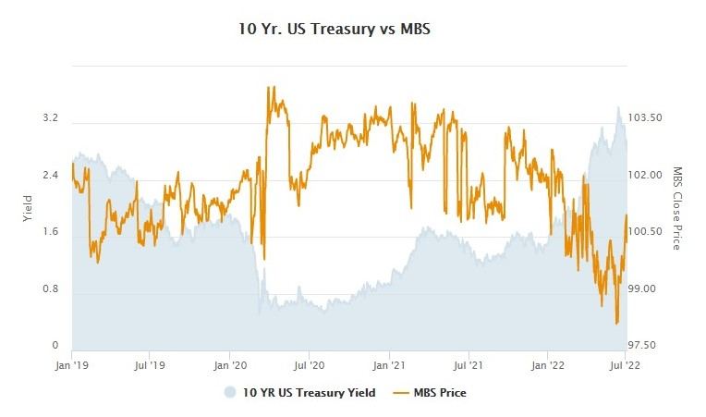
Historical Trend
The MBS bond price and the U.S. Treasury bond yield are negatively correlated. The chart below shows the trend of both since 2019. We can see that the 10-year US treasury bond yield is currently high, while the MBS bond price is at a low level.

